Slide 1

VoiceChat – Bringing chats to life using Deep Learning
Team - 06
K. Laxman Vikas
A. Pavan Kalyan
R. Yogeshwar
Md. Ikramuddin
Guide : Mr. V S. Pavan Kumar

Slide 2

Table Of Contents
1
2
3
INTRODUCTION
OBJECTIVES
USES/ADVANTAGES
4
5
6
WORKFLOW
IMPLEMENTATION
FUTURE SCOPE

Slide 3


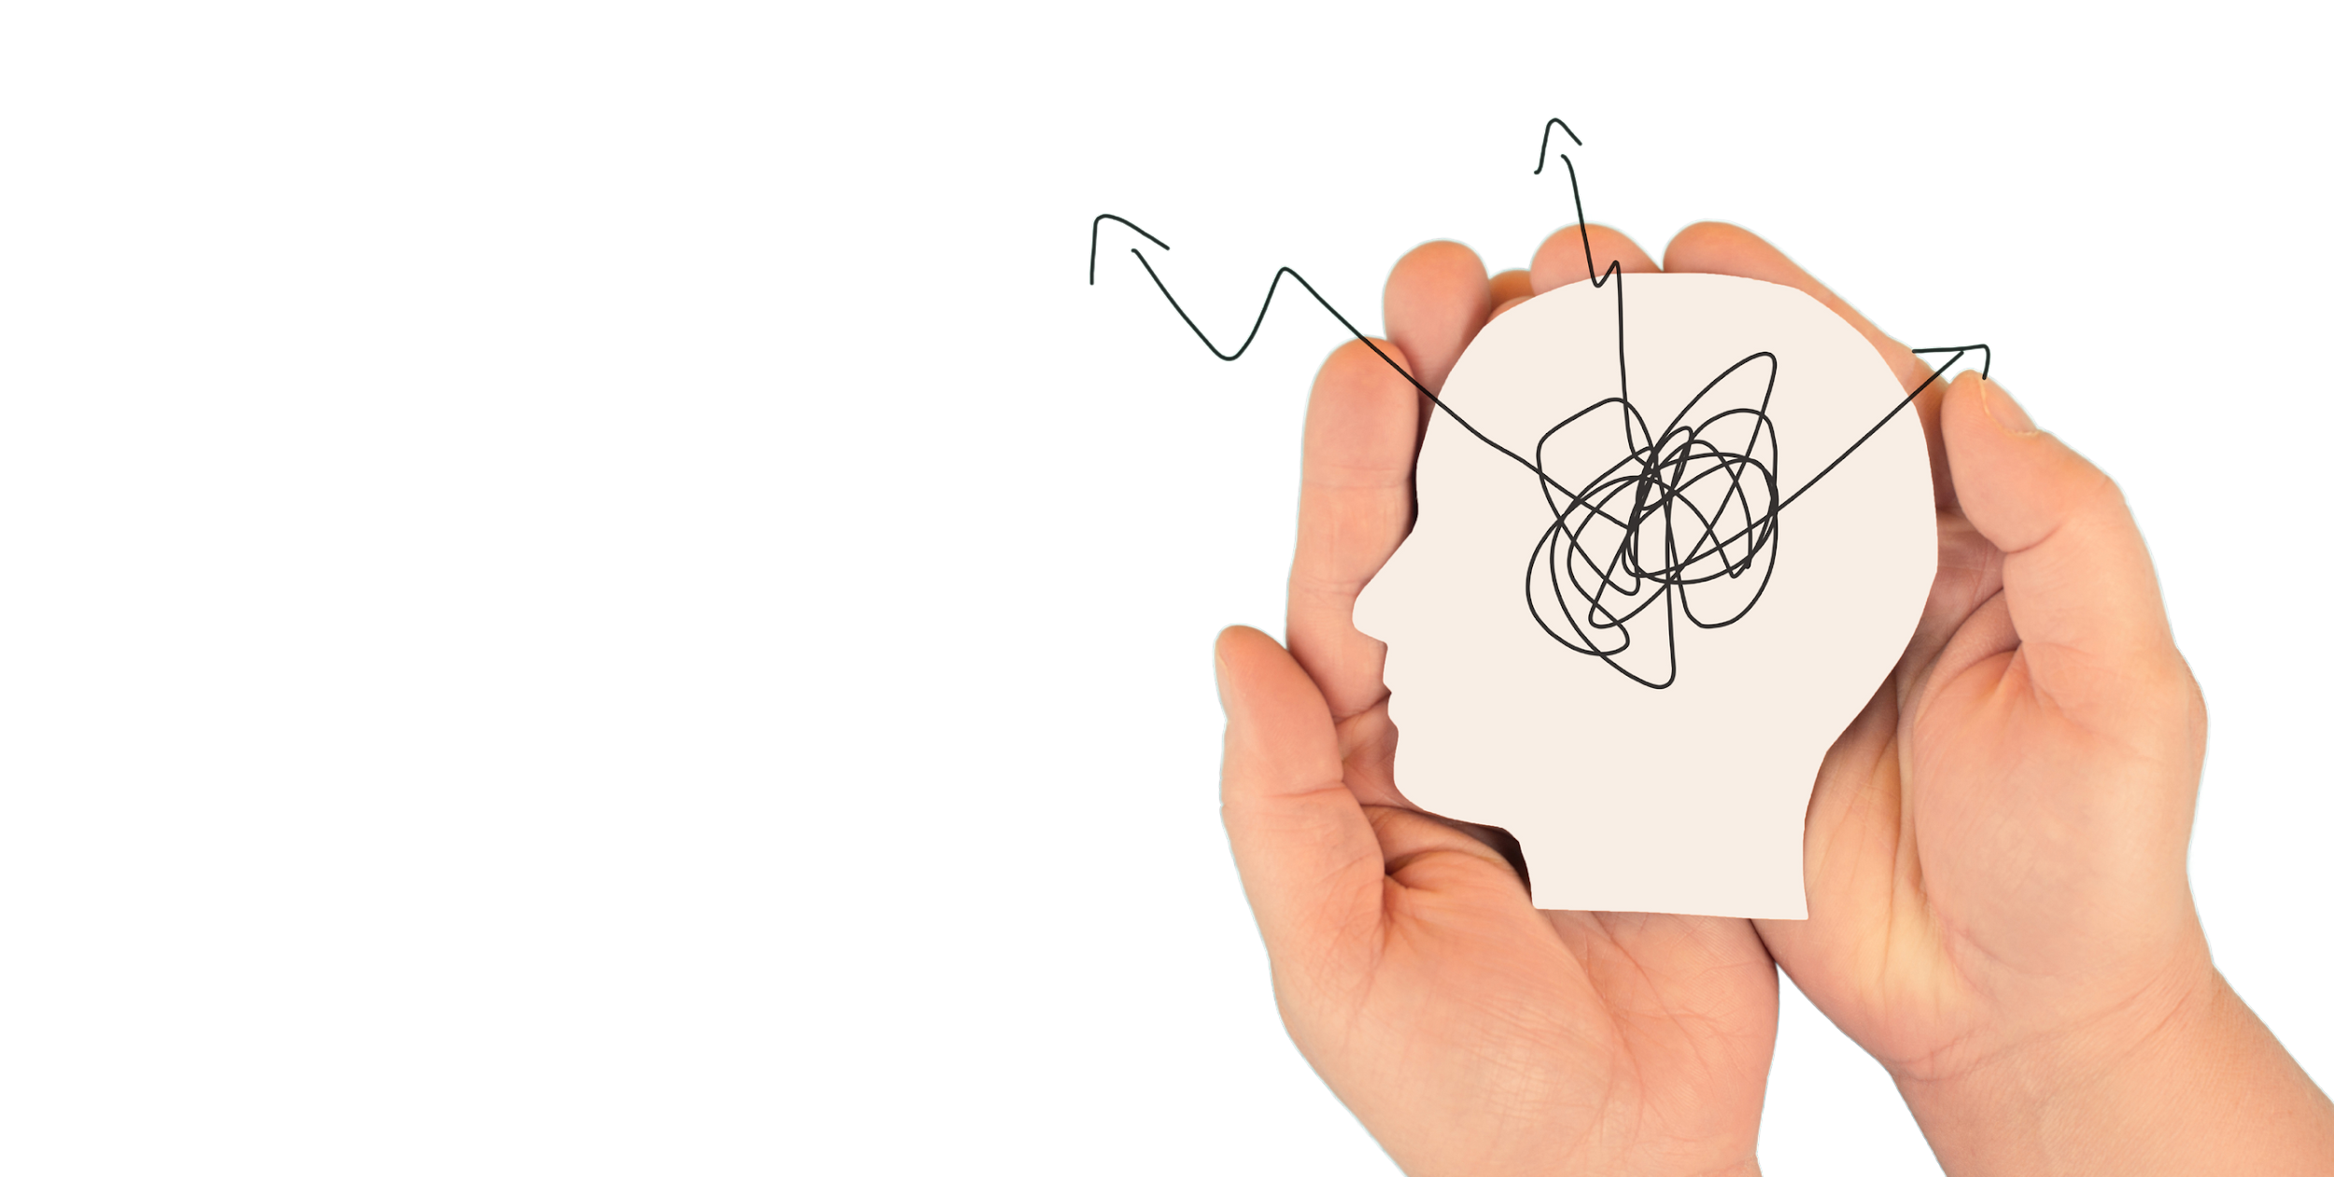
1
INTRODUCTION

Slide 4

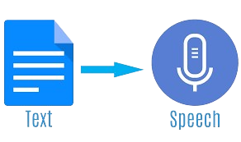
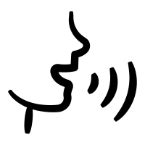
This project leverages cutting-edge technology to enhance digital communication through synthesized audio messages.
Overview:
Built a chat application that reads out text messages in audio format, when clicked on the message.

Slide 5

Text to Speech Conversion
Objectives
Application Development
TTS – App Integration

Slide 6
Uses/Advantages
Accessibility
Enhanced multitasking
Accessible to Visually impaired users and elders.
Useful in situations like driving and multitasking
Increased Convinience
User Friendliness
Increased convenience in reading lengthy messages
User friendly interface with reduced cognitive load

Slide 7



3
Workflow and Implementation

Slide 8
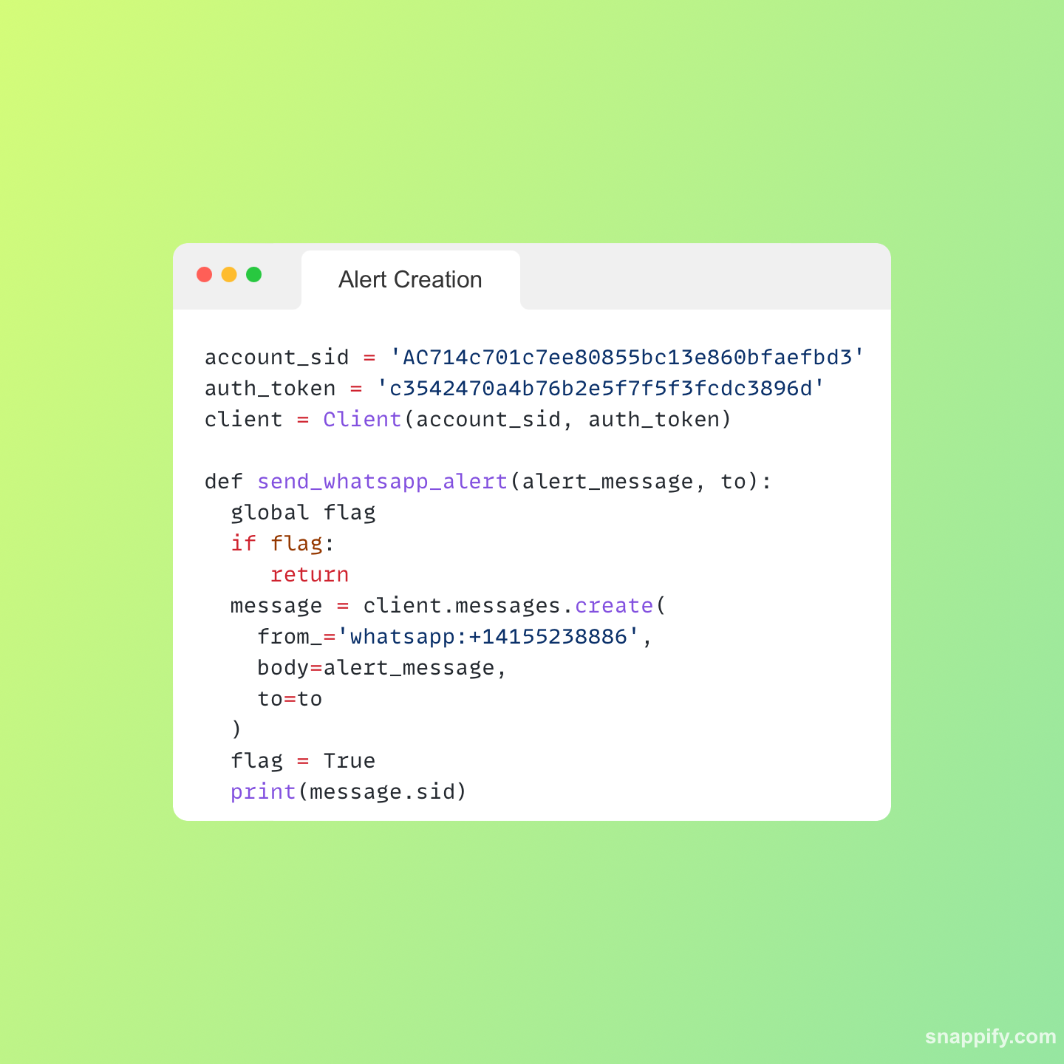
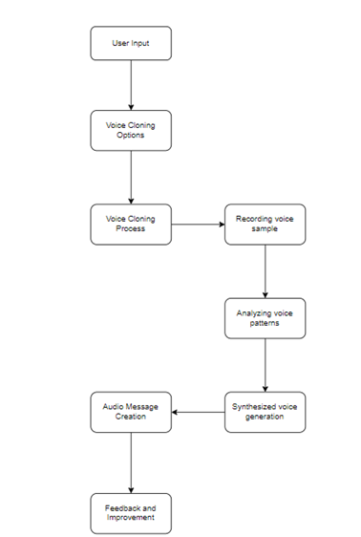
Workflow of
Text-to-Speech system

Slide 9
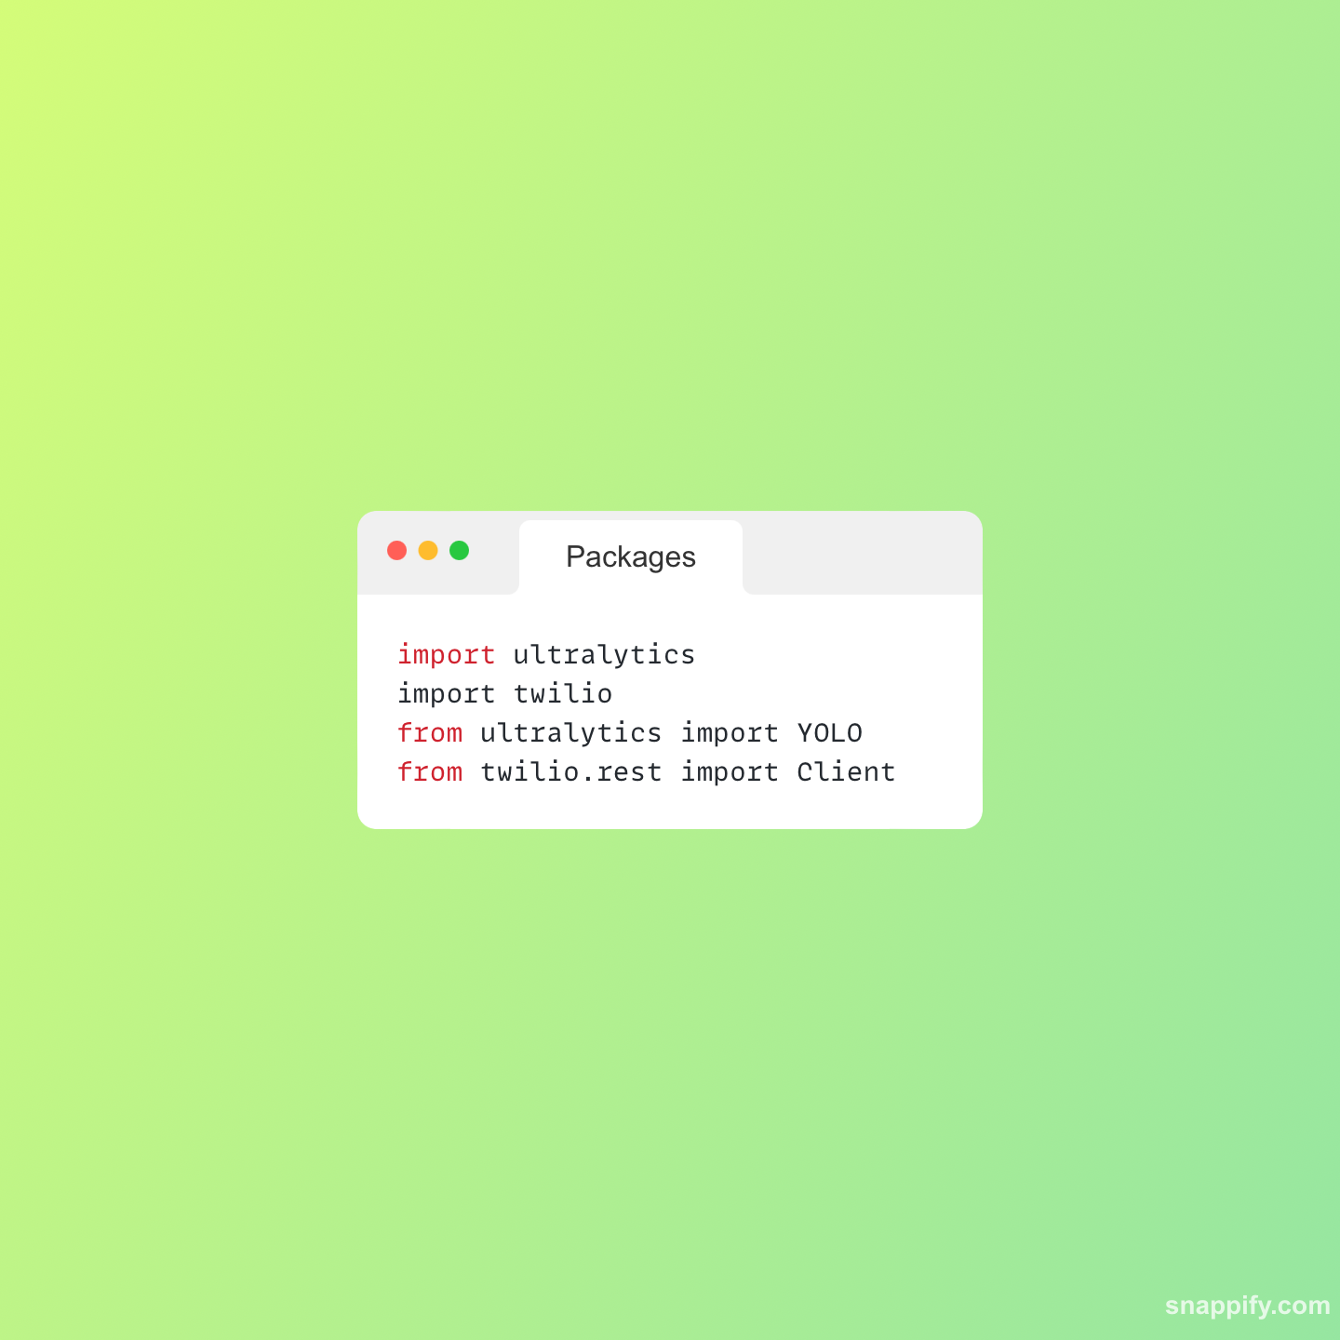
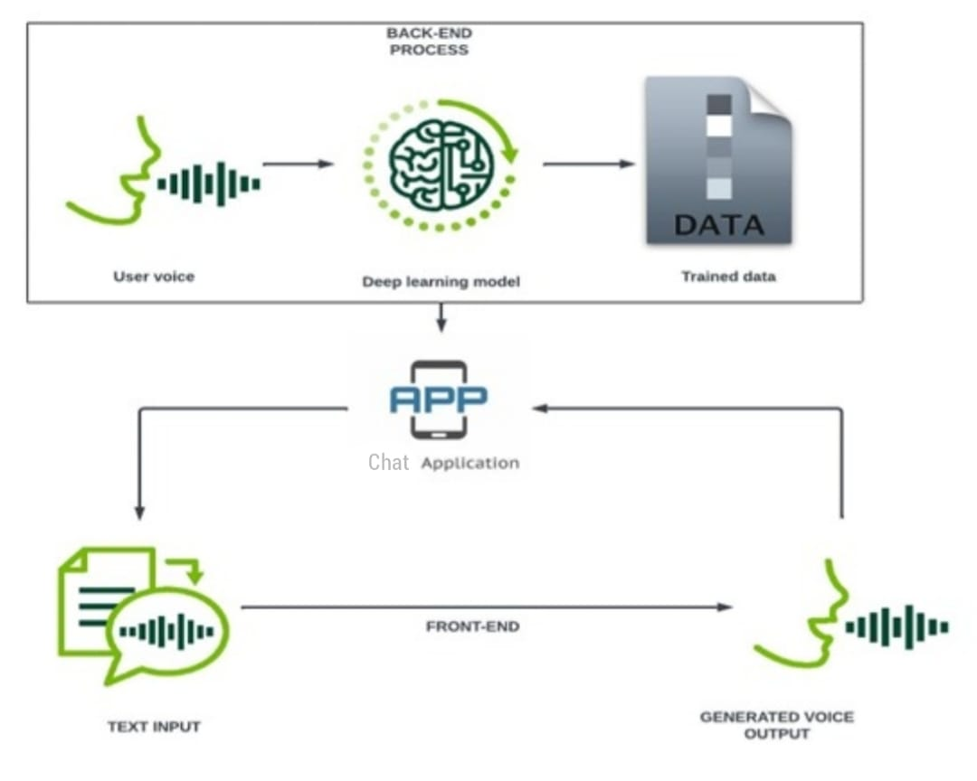
Workflow of
Application

Slide 10
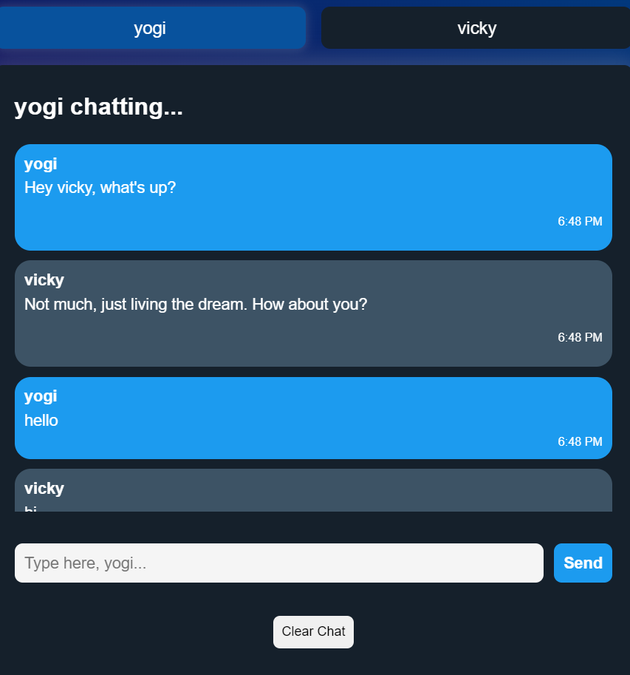
Implementation

Slide 11
Conclusion and Future Scope
Advanced Deep Learning Algorithms
End-to-end security
Added emotions

Slide 12


